Slide 1

SECD2523 DATABASE
SQL 5a | TCL

Slide 2
LECTURE LEARNING OUTCOME
By the end of this lecture, students should be able to:
Construct SQL statements for
01
View
02
Transaction

Slide 3
01
View
02
Transaction

Slide 4
Before we continue this TCL, we reuse the same database same tables created in DML3
If failed to find the database and tables you created previously,
refer here to get our SQL statements to prepare all tables and sample data… https://docs.google.com/document/d/1jC5daHE4WhP7N9U6ZxqRzBJcJAzqJxf1/edit?usp=sharing&ouid=112935562328060013817&rtpof=true&sd=true

Slide 5
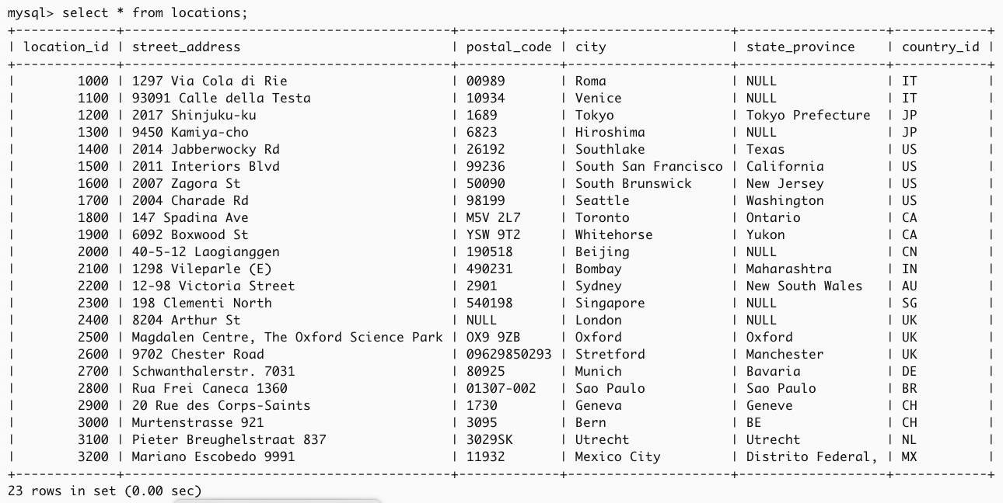
Here, our tables with records
select * from locations;

Slide 6
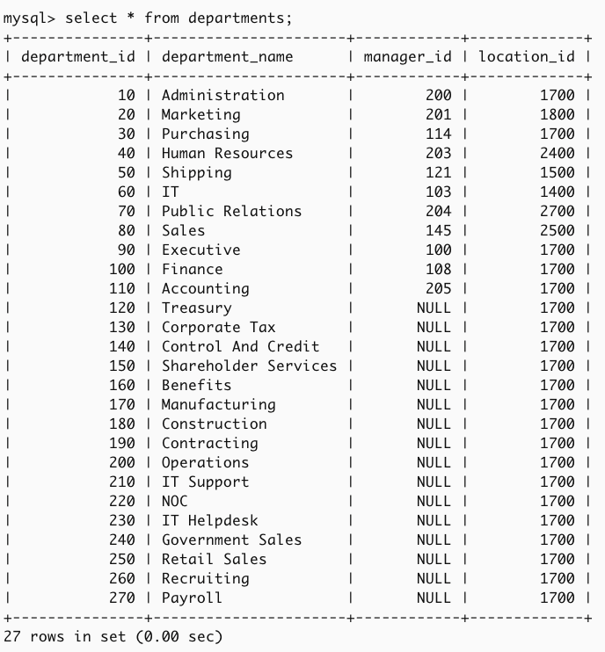
Here, our tables with records
select * from departments;

Slide 7
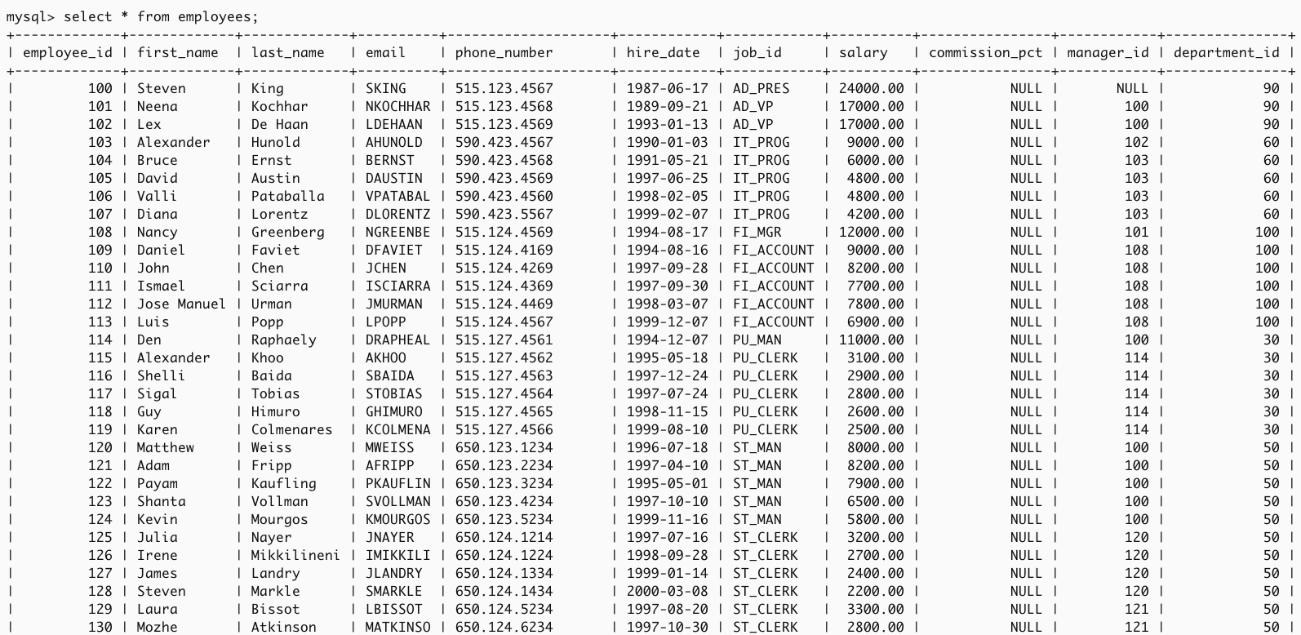
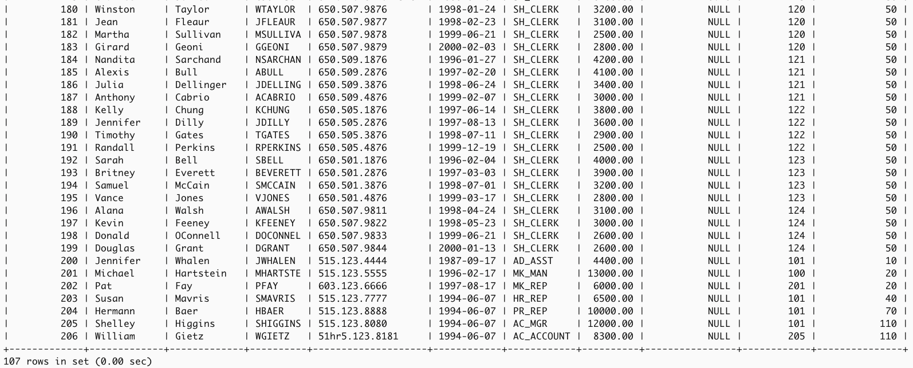
Here, our tables with records
select * from employees;

Slide 8
Let’s start…

Slide 9
View

Slide 10
View
Virtual table
is defined by using an SQL SELECT statement to one or more base tables
looks like a regular table with named columns and rows of data
doesn’t store the data itself in the database
To create a view:
MySQL:
CREATE VIEW ViewName [(column_list)] (optional)
AS subselect
[WITH CHECK OPTION] (optional);

Slide 11
View
CREATE VIEW ViewName [(column_list)] (optional)
AS subselect
[WITH CHECK OPTION] (optional);
A subselect is known as the defining query to the view
If provide a list of column names, it must match the number of columns produced by the subselect
If you don't specify column names, the view will automatically use the column names from the subselect
You must provide column names if there's any confusion or ambiguity, such as:
When the subselect includes calculated columns without names (e.g., no AS clause was used).
When a join produces two columns with the same name.

Slide 12
SELECT * FROM employees;
we are going to focus on department_id = 60 in the following examples…

Slide 13
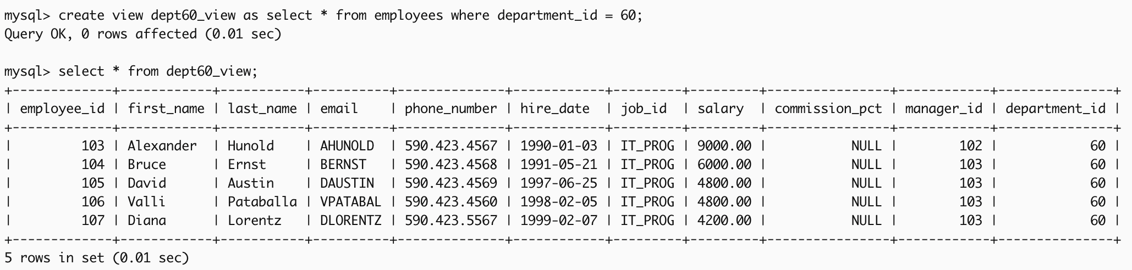
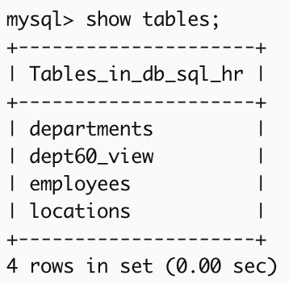
Create a horizontal view
Example 1:
Create a view so that the head of department_id=60 can see the details only for staff who work in his or her department.
Once done created,
execute the following statement
to get the result view
CREATE VIEW dept60_view
AS
SELECT * FROM employees
WHERE department_id = 60;
To ensure the head of the department sees only specific rows:
do not give them access to the base table employees.
instead, give them access to the view dept60_view.
SELECT * FROM dept60_view;

Slide 14
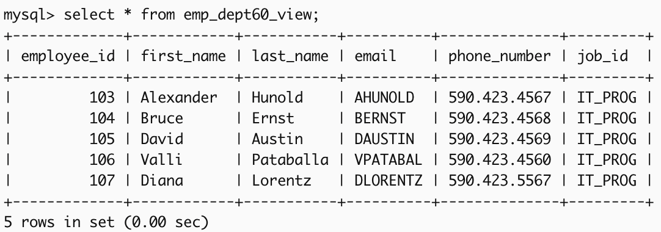
Create a vertical view
Example 2:
Create a view of employees' detail at department_id=60 that exclude salary, so that only the head of the department can access the salary details for employees who work at their department.
or
To keep salary details private:
do not give employees at department_id 60 access to the base table employees or dept60_view.
instead, give them access to the view emp_dept60_view which hides salary.
CREATE VIEW emp_dept60_view
AS
SELECT employee_id, first_name, last_name, email, phone_number, job_id FROM employees WHERE department_id = 60;
CREATE VIEW emp_dept60_view
AS
SELECT employee_id, first_name, last_name, email, phone_number, job_id FROM dept60_view;
this view is created from the previous slide

Slide 15
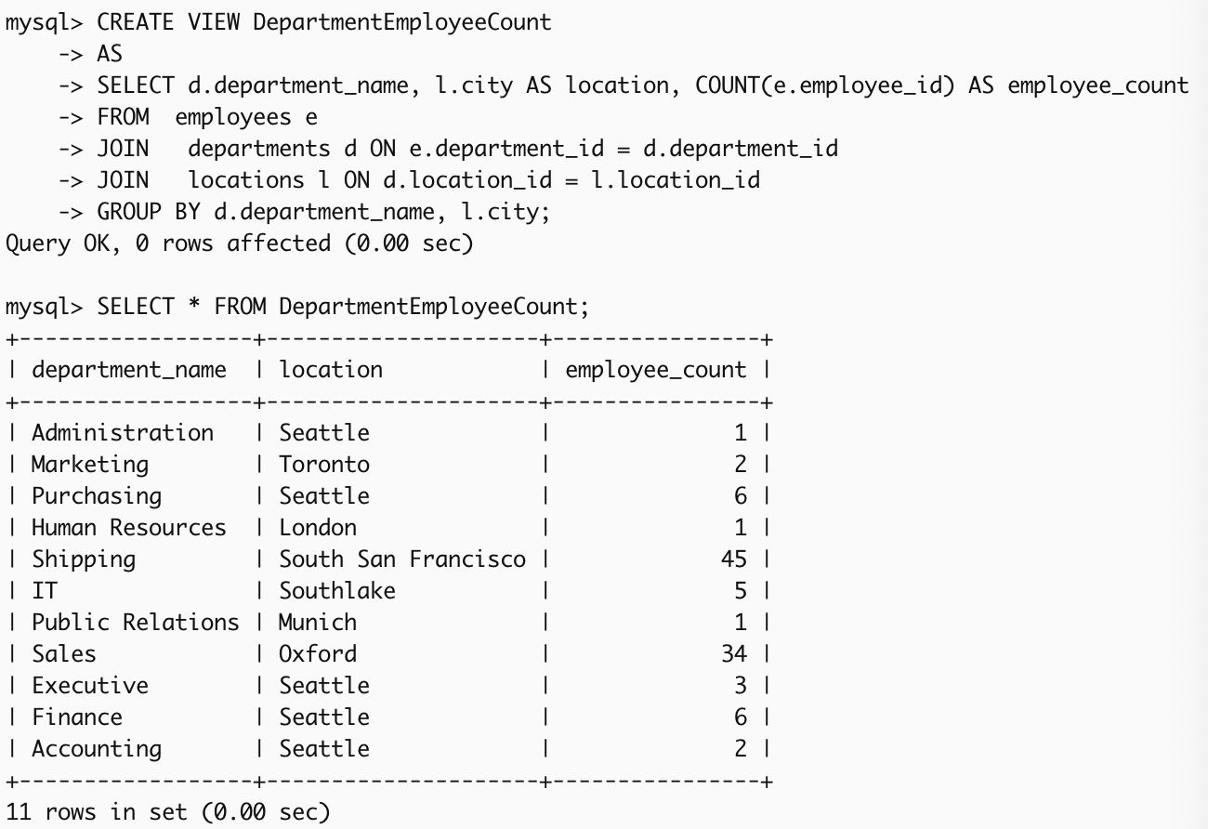
Create a grouped and joined view
Example 3:
Create a view of employees who manage to count of employees working in each department within a specific location.
Once done created, execute the following statement
to get the result view
CREATE VIEW DepartmentEmployeeCount
AS
SELECT d.department_name, l.city AS location, COUNT(e.employee_id) AS employee_count
FROM employees e
JOIN departments d ON e.department_id = d.department_id
JOIN locations l ON d.location_id = l.location_id
GROUP BY d.department_name, l.city;
Grouped view: use of a subselect
Joined view: multiple tables
SELECT * FROM DepartmentEmployeeCount;

Slide 16
Removing a View (DROP VIEW)
To remove a view from the database:
MySQL:
If CASCADE is specified, DROP VIEW will delete the view and all related objects that depend on it. This means any views that are based on the view you are dropping will also be deleted.
If RESTRICT is specified, the command will only work if there are no dependent objects. If any object depends on the view, the command will be rejected.
Note: The default setting is RESTRICT.
Example 4:
EmployeeInfo view select basic employee information from employee table, EmployeeDetail view select a part information from EmployeeInfo view.
DROP VIEW EmployeeInfo CASCADE; it will delete EmployeeInfo and also remove EmployeeDetail since it depends on EmployeeInfo.
DROP VIEW EmployeeInfo RESTRICT; it will fail and the view won’t be dropped since EmployeeDetail still depends on EmployeeInfo.
DROP VIEW ViewName [RESTRICT | CASCADE] (optional);
employee
EmployeeInfo
EmployeeDetail

Slide 17
View - WITH CHECK OPTION
CREATE VIEW … WITH CHECK OPTION
prohibits a row from migrating out of the view
WITH LOCAL CHECK OPTION: any row inserted or updated in the view (or any view that depends on it) must remain visible in the view after the operation. If a row is inserted or updated, it cannot be removed from the view unless it is also removed from the underlying table or view that the original view is based on.
WITH CASCADED CHECK OPTION: default setting and ensures that any row inserted or updated into a view, and any views directly or indirectly defined on it (a row must satisfy all conditions in the chain of dependent views, not just the immediate view where the operation occurs. If any condition fails, the operation is rejected.)
MySQL:
CREATE VIEW ViewName [(column_list)] (optional)
AS subselect
[WITH (LOCAL/CASCADED) CHECK OPTION] (optional);

Slide 18
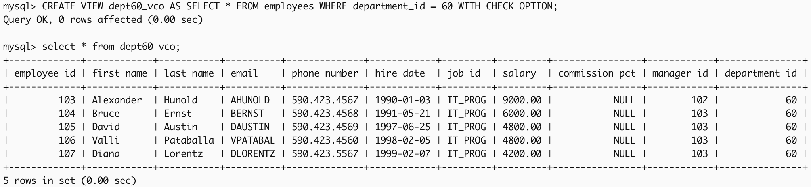
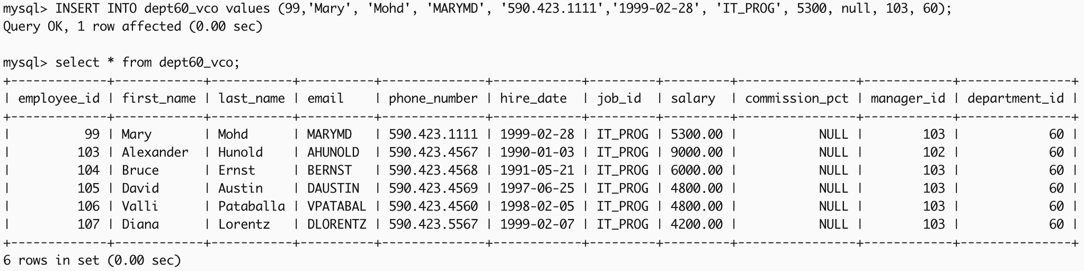
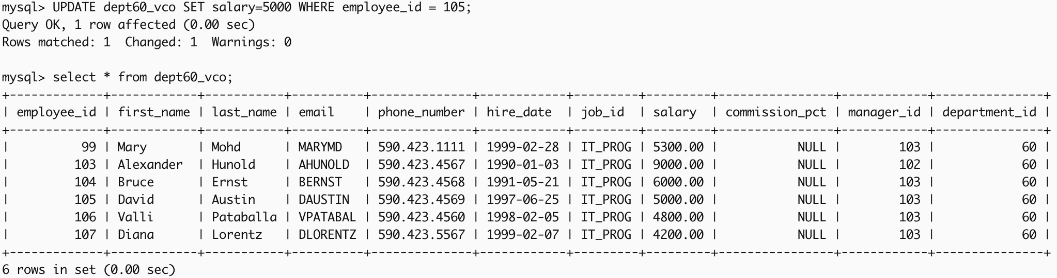
View - WITH CHECK OPTION
Example 5:
Create a view with check option so that the head of department_id=60 can see the details only for staff who work in his or her department.
Once done created,
now attempt to insert new values (99,'Mary', 'Mohd', 'MARYMD', '590.423.1111’, '1999-02-28', 'IT_PROG', 5300, null, 103, 60)
now attempt to update the salary for employee_id = 105 from 4800 to 5000
CREATE VIEW dept60_vco
AS SELECT * FROM employees
WHERE department_id = 60
WITH CHECK OPTION;
INSERT INTO dept60_vco VALUES (99,'Mary', 'Mohd', 'MARYMD', '590.423.1111','1999-02-28', 'IT_PROG', 5300, null, 103, 60);
UPDATE dept60_vco SET salary = 5000 WHERE employee_id = 105;

Slide 19
Transaction – related to topic 7

Slide 20
Transaction
COMMIT
ends the transaction successfully
making the database changes permanent
A new transaction starts after COMMIT with the next transaction-initiating statement.
ROLLBACK
aborts the transaction
backing out any changes made by the transaction
A new transaction starts after ROLLBACK with the next transaction-initiating statement.
MySQL:
SET TRANSACTION [TRANSACTION MODE];
START TRANSACTION;
[SQL Statements];
ROLLBACK or ROLLBACK TO …;
COMMIT;

Slide 21
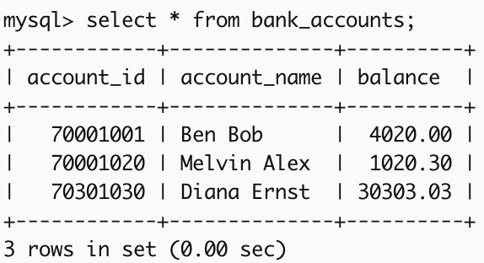
COMMIT / ROLLBACK
Example 1:
Create Table for bank_accounts with account_id, account_name, and balance, then insert sample data before we proceed applying commit or rollback
CREATE TABLE bank_accounts (
account_id INT PRIMARY KEY,
account_name VARCHAR(50),
balance DECIMAL(10,2)
);
INSERT INTO bank_accounts VALUES (70001001, 'Ben Bob', 4020.00),
(70001020, 'Melvin Alex', 1020.30),
(70301030, 'Diana Ernst', 30303.03);
continue to next slide

Slide 22
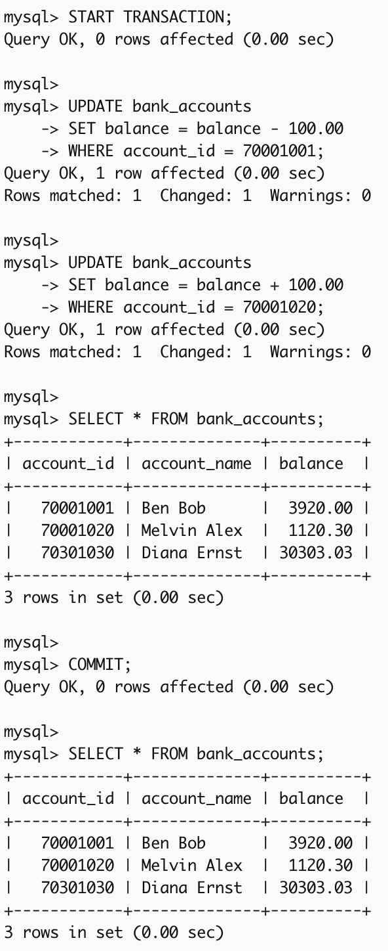
COMMIT / ROLLBACK
Example 1 (continued…):
Now, transfer 100.00
from account_id = 70001001 to account_id = 70001020
START TRANSACTION;
UPDATE bank_accounts
SET balance = balance - 100.00
WHERE account_id = 70001001;
UPDATE bank_accounts
SET balance = balance + 100.00
WHERE account_id = 70001020;
SELECT * FROM bank_accounts;
COMMIT;
SELECT * FROM bank_accounts;
Before Transfer

Slide 23
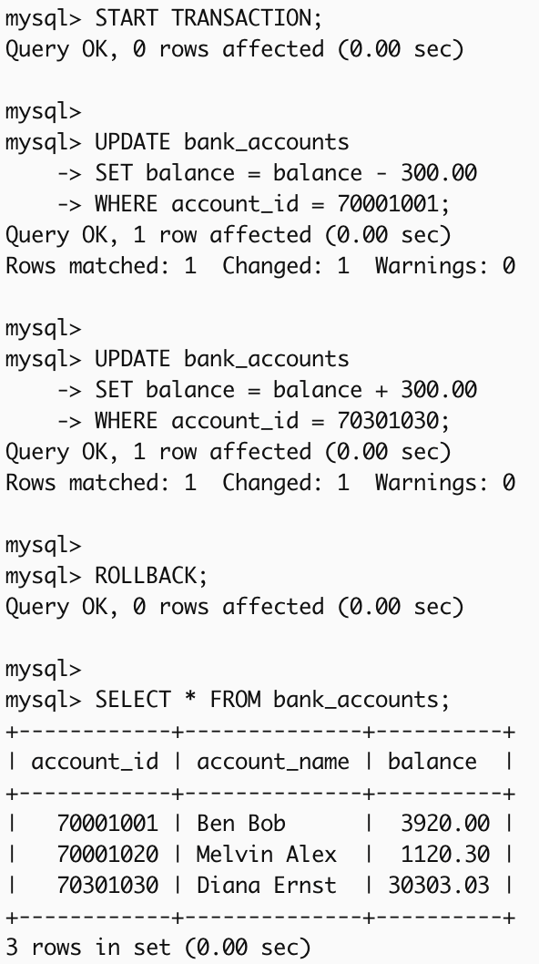
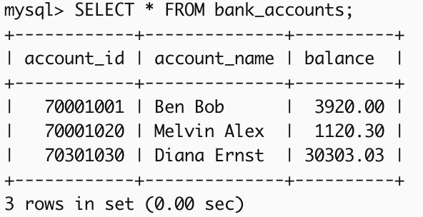
COMMIT / ROLLBACK
Example 2:
Now, attempt to transfer 300.00
from account_id = 70001001 to account_id = 70301030
but realize a mistake occurred, and want to cancel it.
START TRANSACTION;
UPDATE bank_accounts
SET balance = balance - 300.00
WHERE account_id = 70001001;
UPDATE bank_accounts
SET balance = balance + 300.00
WHERE account_id = 70301030;
ROLLBACK;
SELECT * FROM bank_accounts;
Before Attempt to Transfer

Slide 24
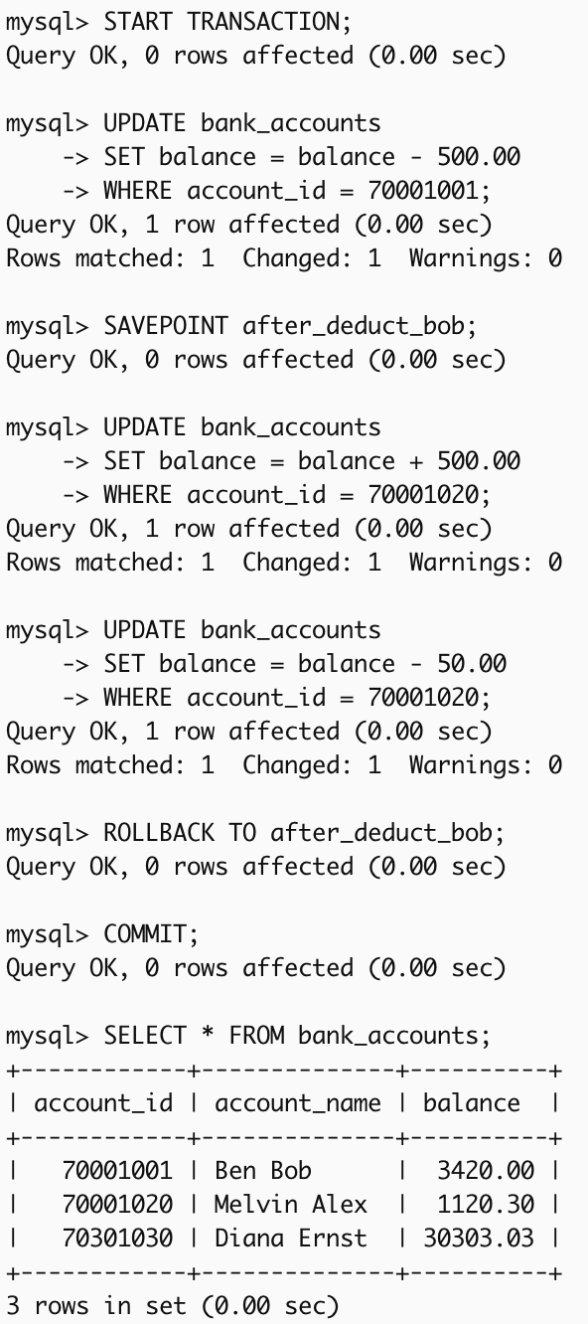
SAVEPOINT
Example 3:
Now, attempt to transfer 500.00 from account_id = 70001001 to account_id = 70001020,
then a fee of 50.00 is attempted to deduct from account_id = 70001020, but something goes wrong.
START TRANSACTION;
UPDATE bank_accounts
SET balance = balance - 500.00
WHERE account_id = 70001001;
SAVEPOINT after_deduct_bob;
UPDATE bank_accounts
SET balance = balance + 500.00
WHERE account_id = 70001020;
UPDATE bank_accounts
SET balance = balance - 50.00
WHERE account_id = 70001020;
ROLLBACK TO after_deduct_bob;
COMMIT;
SELECT * FROM bank_accounts;
Before Attempt to Transfer

Slide 25
Summary
Command | Purpose
COMMIT | Saves all changes made during the transaction.
ROLLBACK | Undoes all changes made during the transaction, reverting to the start.
SAVEPOINT | Creates a checkpoint within the transaction to partially roll back changes.

Slide 26
Transaction Modes
READ ONLY
ensures no changes can be made to the database within that transaction
restrict write operations (like INSERT, UPDATE, or DELETE)
retrieve data only
READ WRITE
(default) allows both reading and modifying data
MySQL:
SET TRANSACTION [READ ONLY | READ WRITE];
START TRANSACTION;
[SQL Statements];
ROLLBACK or ROLLBACK TO …;
COMMIT;

Slide 27
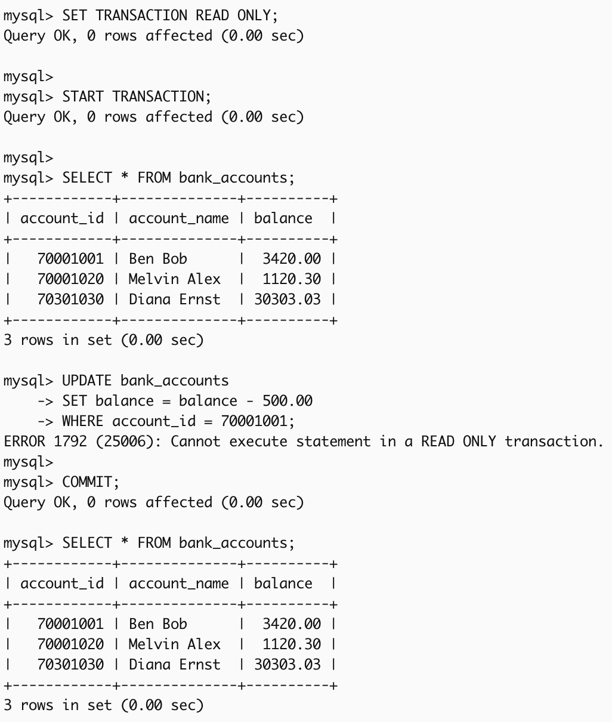
SET TRANSACTION [READ ONLY | READ WRITE];
Example 4
attempt to transfer 500.00 out but the transaction mode sets to READ ONLY
SET TRANSACTION READ ONLY;
START TRANSACTION;
SELECT * FROM bank_accounts;
UPDATE bank_accounts
SET balance = balance - 500.00
WHERE account_id = 70001001;
COMMIT;

Slide 28
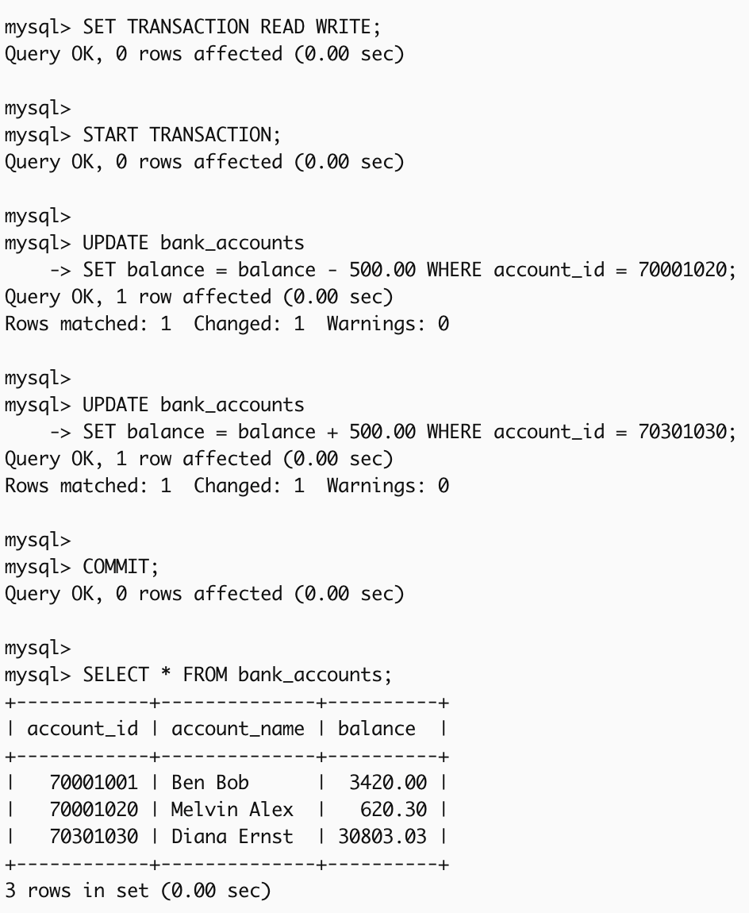
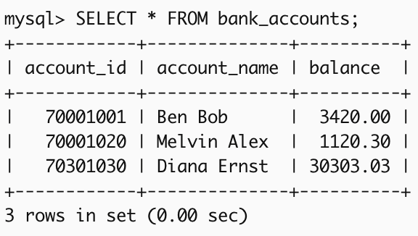
SET TRANSACTION [READ ONLY | READ WRITE];
Example 5
attempt to transfer 500.00 from account_id = 70001020 to account_id = 70301030
Before Attempt to Transfer
SET TRANSACTION READ WRITE;
START TRANSACTION;
UPDATE bank_accounts
SET balance = balance - 500.00 WHERE account_id = 70001020;
UPDATE bank_accounts
SET balance = balance + 500.00 WHERE account_id = 70301030;
COMMIT;
SELECT * FROM bank_accounts;

Slide 29
Transaction Modes
ISOLATION LEVEL READ UNCOMMITTED
allows reading uncommitted changes from other transactions
ISOLATION LEVEL READ COMMITTED
ensures that only committed changes are visible (no reading uncommitted changes)
ISOLATION LEVEL REPEATABLE READ
(default) ensures that data read within a transaction remains consistent, even if other transactions modify the data
ISOLATION LEVEL SERIALIZABLE
ensures full isolation by locking the rows, preventing other transactions from accessing them until the transaction is complete
MySQL:
SET TRANSACTION [ISOLATION LEVEL READ UNCOMMITTED | READ COMMITTED | REPEATABLE READ | SERIALIZABLE];
START TRANSACTION;
[SQL Statements];
ROLLBACK or ROLLBACK TO …;
COMMIT;

Slide 30
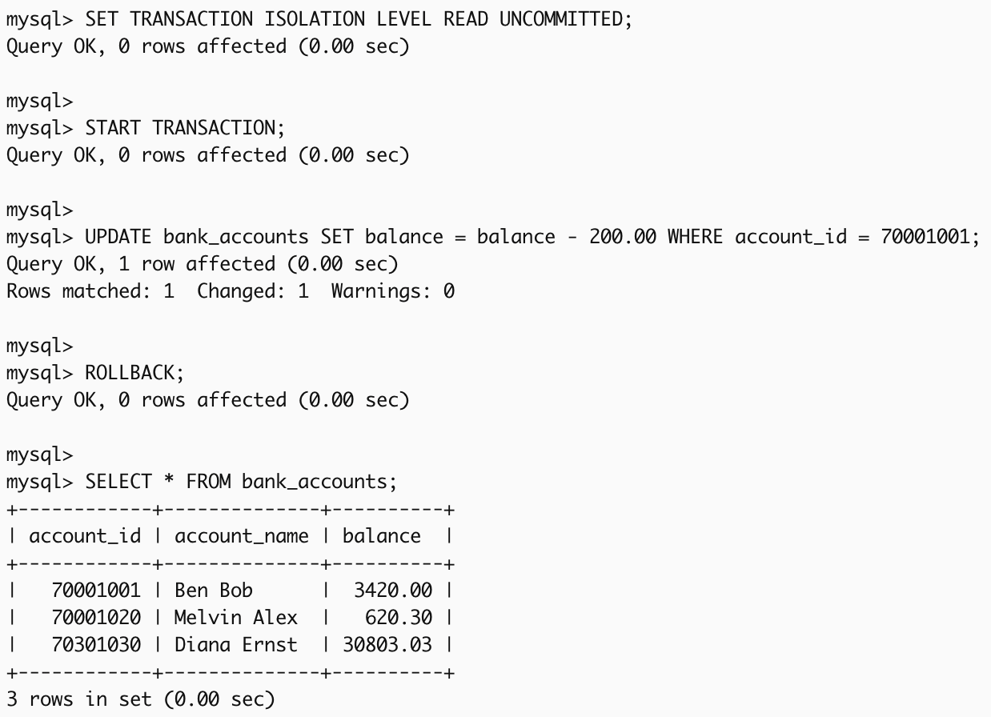
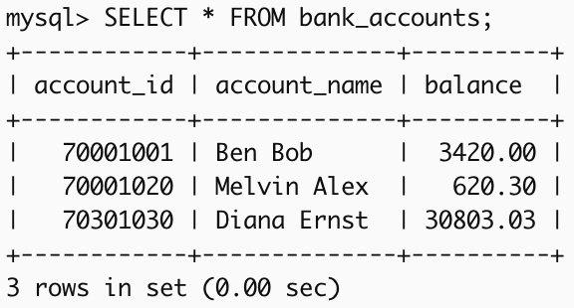
SET TRANSACTION [ISOLATION LEVEL READ UNCOMMITTED | READ COMMITTED | REPEATABLE READ | SERIALIZABLE];
Example 6
balance of account_id = 70001001 is temporarily updated to deduct 200 in the database. However, this transaction has not been committed yet, this change is still uncommitted and might not be finalized.
SET TRANSACTION ISOLATION LEVEL READ UNCOMMITTED;
START TRANSACTION;
UPDATE bank_accounts SET balance = balance - 200.00 WHERE account_id = 70001001;
ROLLBACK;
SELECT * FROM bank_accounts;
Before transaction

Slide 31
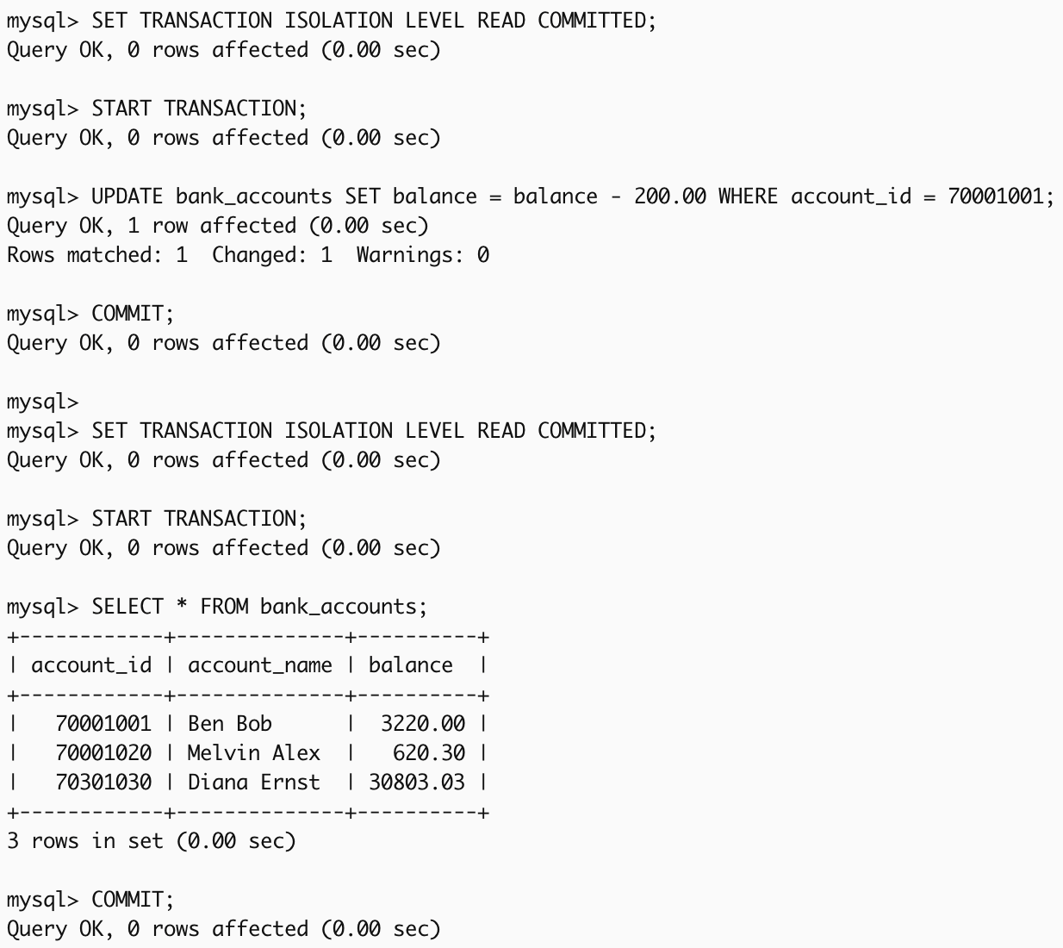
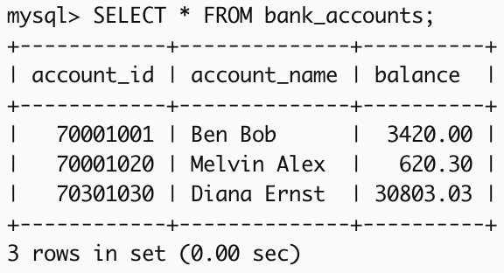
SET TRANSACTION [ISOLATION LEVEL READ UNCOMMITTED | READ COMMITTED | REPEATABLE READ | SERIALIZABLE];
Example 7
Transaction 1: balance of account_id = 70001001 is updated to deduct 200 in the database and commit changes.
Transaction 2: can see the committed changes from Transaction 1.
SET TRANSACTION ISOLATION LEVEL READ COMMITTED;
START TRANSACTION;
UPDATE bank_accounts SET balance = balance - 200.00 WHERE account_id = 70001001;
COMMIT;
SET TRANSACTION ISOLATION LEVEL READ COMMITTED;
START TRANSACTION;
SELECT * FROM bank_accounts;
COMMIT;
Before transaction

Slide 32
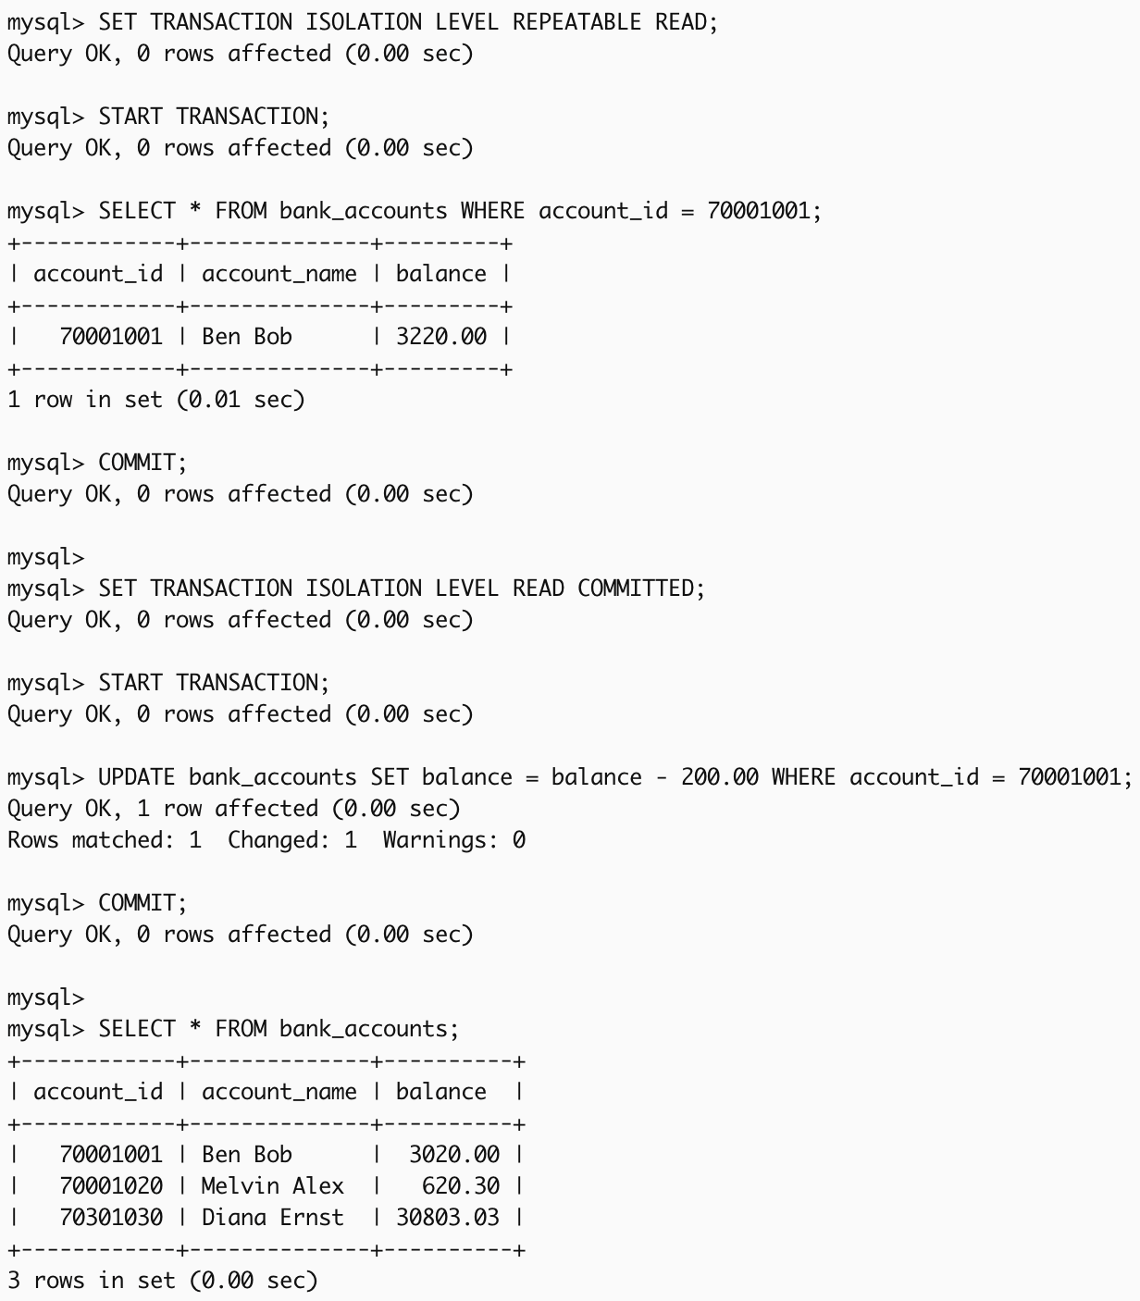

SET TRANSACTION [ISOLATION LEVEL READ UNCOMMITTED | READ COMMITTED | REPEATABLE READ | SERIALIZABLE];
Example 8
Transaction 1: view balance of account_id = 70001001 and commit under REPEATABLE READ.
Transaction 2: update balance of account_id = 70001001 to deduct 200 in the database.
SET TRANSACTION ISOLATION LEVEL REPEATABLE READ;
START TRANSACTION;
SELECT * FROM bank_accounts WHERE account_id = 70001001;
COMMIT;
SET TRANSACTION ISOLATION LEVEL READ COMMITTED;
START TRANSACTION;
UPDATE bank_accounts SET balance = balance - 200.00 WHERE account_id = 70001001;
COMMIT;
SELECT * FROM bank_accounts;
Before transaction

Slide 33
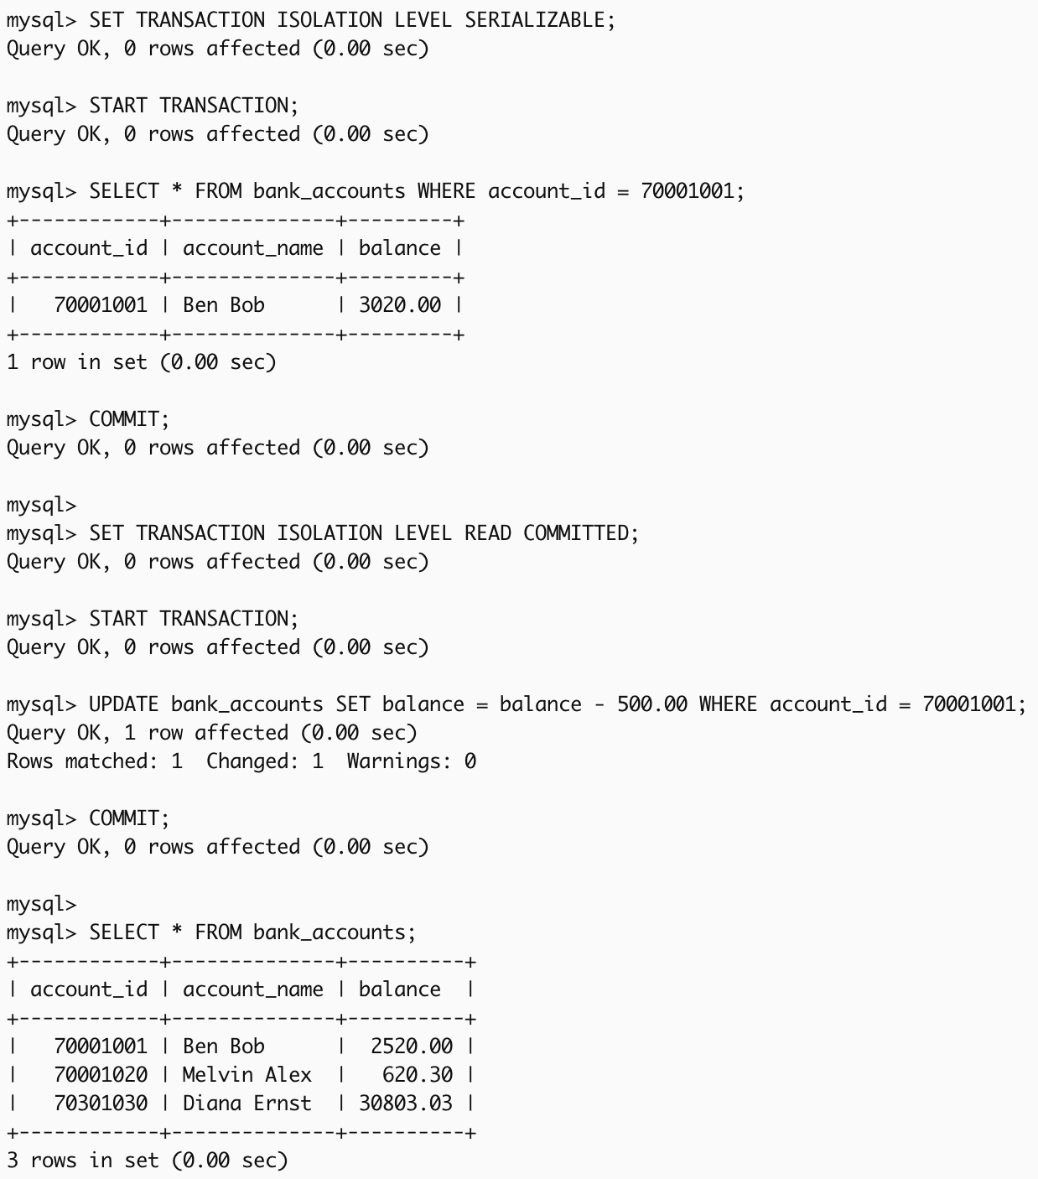
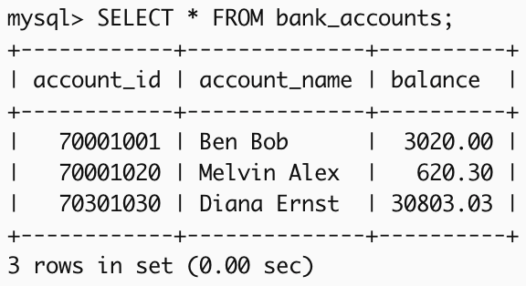
SET TRANSACTION [ISOLATION LEVEL READ UNCOMMITTED | READ COMMITTED | REPEATABLE READ | SERIALIZABLE];
Example 9
Transaction 1: view balance of account_id = 70001001 and commit under SERIALIZABLE.
Transaction 2: update balance of account_id = 70001001 to deduct 500 in the database.
SET TRANSACTION ISOLATION LEVEL SERIALIZABLE;
START TRANSACTION;
SELECT * FROM bank_accounts WHERE account_id = 70001001;
COMMIT;
SET TRANSACTION ISOLATION LEVEL READ COMMITTED;
START TRANSACTION;
UPDATE bank_accounts SET balance = balance - 500.00 WHERE account_id = 70001001;
COMMIT;
SELECT * FROM bank_accounts;
Before transaction

Slide 34
Summary
Mode | What It Does
READ ONLY | Ensures no data can be modified during the transaction.
READ WRITE | Allows both reading and modifying data during the transaction.
READ UNCOMMITTED | Allows reading uncommitted changes from other transactions (dirty reads).
READ COMMITTED | Prevents dirty reads, but data can still change between reads (non-repeatable reads possible).
REPEATABLE READ | Ensures consistent data for the duration of the transaction (no dirty or non-repeatable reads).
SERIALIZABLE | Ensures complete isolation by locking rows, preventing phantom reads or any concurrent access.

Slide 35


